Slide 1
The Impact of AI-Supported Learning on Financial Literacy: Evidence from a Randomized Controlled Trial
Preliminary Results
Jaime Polanco-Jimenez¹ & Kristof De Witte²
¹ LEER - KU Leuven & Pontificia Universidad Javeriana, Colombia
² LEER - KU Leuven, UNU-Merit & Maastricht University

Slide 2
Outline
Brief overview
Context, Literature Review and Contribution
Methodology
Data
Results
Robustness Check and Attrition Selection
Conclusions

Slide 3
This paper
Question: Can Generative AI tools improve financial literacy outcomes in the Belgian secondary school context?
Is this effect different in the context of teacher shortages?
Motivation: Financial literacy is crucial for economic well-being (Behrman et al., 2012), and interventions can influence student economic preferences (Sutter et al., 2020).
How:
RCT identifying the causal effect of AI chatbots vs. a traditional learning path.
Comparing: Control (Traditional Learning Path) vs. Treatment 1 (Reduced TLP + AI) vs. Treatment 2 (Tailored AI)
Data from N=2236 students in Belgium that have started the learning path.
We find:
Main outcome: Increase 0.07 sd (T1) and 0.04 sd (T2) relative to Control.
Psychosocial and Emotional Outcomes: AI is “as good as” the traditional path

Slide 4
Context, Literature Review and Contribution
1

Slide 5
Context: Why Financial Literacy in Flemish Secondary Schools?
Curriculum Reform (since 2019):
Economic and Financial Literacy (EFL) integrated as a key competence for all students.
Equipping youth with essential skills (budgeting, saving, understanding taxes, etc.).
Societal Relevance:
Navigating a complex financial world (online banking, credit, economic crises).
Aims to prevent debt and improve financial resilience.
Broader Importance:
Democratic Citizenship: Understanding economic policy, taxes, labor markets.
International Influence: Response to EU/OECD recommendations (e.g., PISA).
Equity: Schools play a key role in bridging socioeconomic gaps in financial knowledge

Slide 6
AI in Education & Relevance for Financial Literacy
Adaptive Content Delivery for Complex Topics:
AI systems tailor content to student abilities (Wang et al., 2024; Pardamean et al., 2022).
Relevance for FL: Crucial for navigating complex financial concepts (e.g., Belgian taxes, investment risk) at an individual pace, ensuring foundational understanding before tackling advanced topics (need for effective instructional approaches, Salas Velasco and Jose, 2020).
Real-time Feedback to Address Biases Misconceptions:
Immediate, personalized feedback enhances learning (Tee et al., 2023; Yilmaz et al., 2023).
Relevance for FL: Potential to help students identify and reflect on cognitive biases (e.g., myopia as in Pitthan and De Witte, 2022) in real-time during financial problem-solving exercises, a gap in traditional methods.
Personalized Learning Paths for Varied Needs Preferences:
AI creates customized learning trajectories (Naseer et al., 2024; Sancenon et al., 2022).
Relevance for FL: Can accommodate diverse prior knowledge and learning preferences regarding financial topics, potentially improving engagement and long-term behavioral change, which is often a challenge (Lewis and L., 2009; Frisancho, 2022).

Slide 7
AI in Education & Relevance for Financial Literacy
Enhanced Engagement for a Traditionally Dry Subject:
AI-enhanced learning can increase student engagement (University and De La Salle University, 2024; Dingli and Caruana Montaldo, 2020).
Relevance for FL: Financial topics can be perceived as dry; interactive AI tools (like chatbots) can make learning more dynamic and relatable, potentially improving motivation which is key for effective learning (cf. need for engaging approaches, Salas Velasco and Jose, 2020).
Improved Critical Thinking for Real-World Financial Decisions:
AI tools can support higher-order cognitive skills (Qin and Chia, 2024; Guishca Ayala et al., 2024).
Relevance for FL: Essential for developing the ability to analyze complex financial scenarios, evaluate risks/rewards, and make informed decisions – moving beyond rote memorization to practical financial competence (cf. challenge of application, Salas Velasco and Jose, 2020).

Slide 8
Contribution: Pioneering AI in Financial Literacy Education
While general AI in education is a rapidly expanding field (e.g., Tlili et al., 2025; Wang et al., 2024), key gaps remain.
Novelty: This study, to our knowledge, is the first to:
Investigate the causal impact of AI tools on financial literacy education.
Assess “Psychosocial and Emotional Outcomes”, → extending beyond typical academic measures in AIEd¹ studies (Tlili et al., 2025).
Provide such evidence from the Belgian secondary school system.
Tailored vs. Generic AI Chatbots: Moves beyond studying general chatbot efficacy (Wu and Yu, 2023).→ hyper-tailored to the complex domain of the Belgian tax system.
¹Artificial Intelligence in Education (AIEd)

Slide 9
Contribution: Methodological Rigor & Nuanced Investigation
Quantifying Impact: Provides clear, statistically significant effect sizes (0.04-0.07 sd). This enhances the evidence base in a field where precise impact quantification of AI interventions can often be limited.
Beyond Academic Scores: Provides a holistic view by measuring impacts on motivation, self-regulation, and engagement, extending beyond typical academic outcome measures.
¹Artificial Intelligence in Education (AIEd)

Slide 10
Methodology
2
10
Faculty, department, unit ...

Slide 11
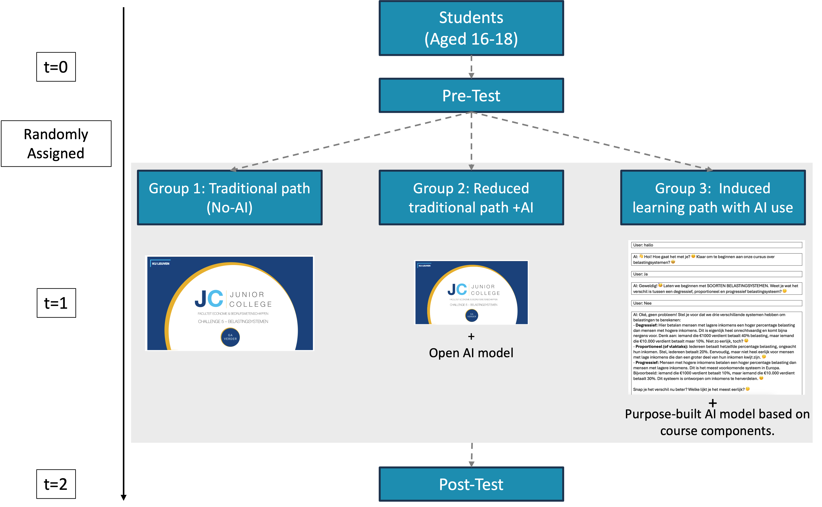
A Multifaceted Picture (Summary of Evidence)
The sample size of 732 was determined by a power analysis (α = 0.05, power = 0.80), assuming a medium effect size (Cohen’s d = 0.2) for the primary outcome: the post-test score difference between the combined AI groups and the control group.

Slide 12


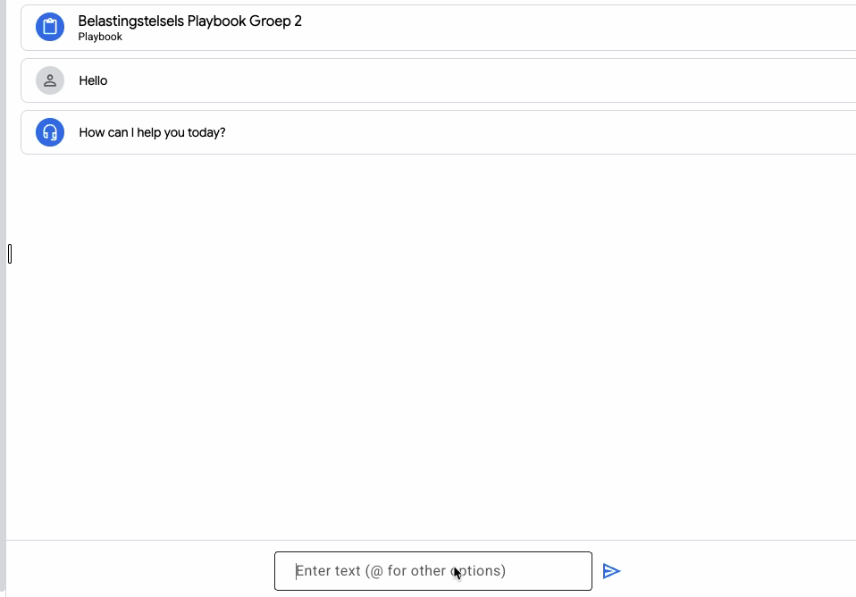

Treatment Group 1: AI – Supplemented Traditional Materials
+

Slide 13
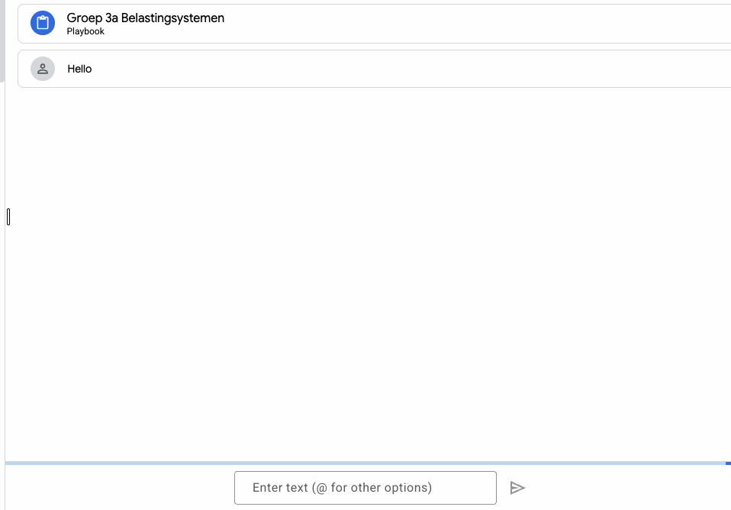
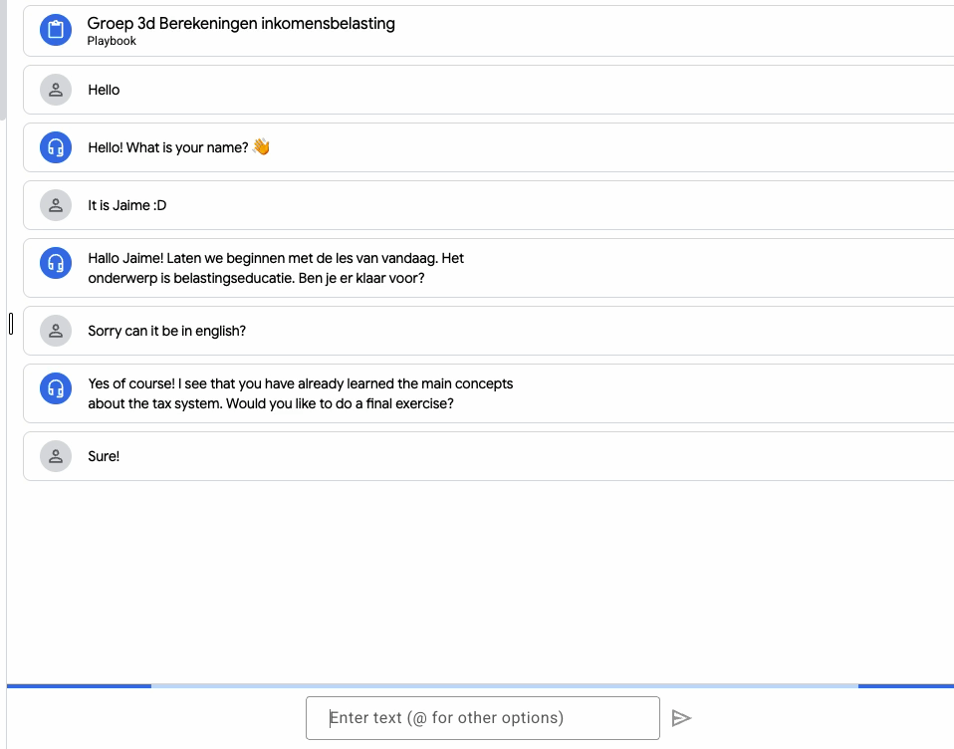
Treatment Group 2: Tailored AI

Slide 14
Data
3
14
14
Faculty, department, unit ...
Faculty, department, unit ...

Slide 15
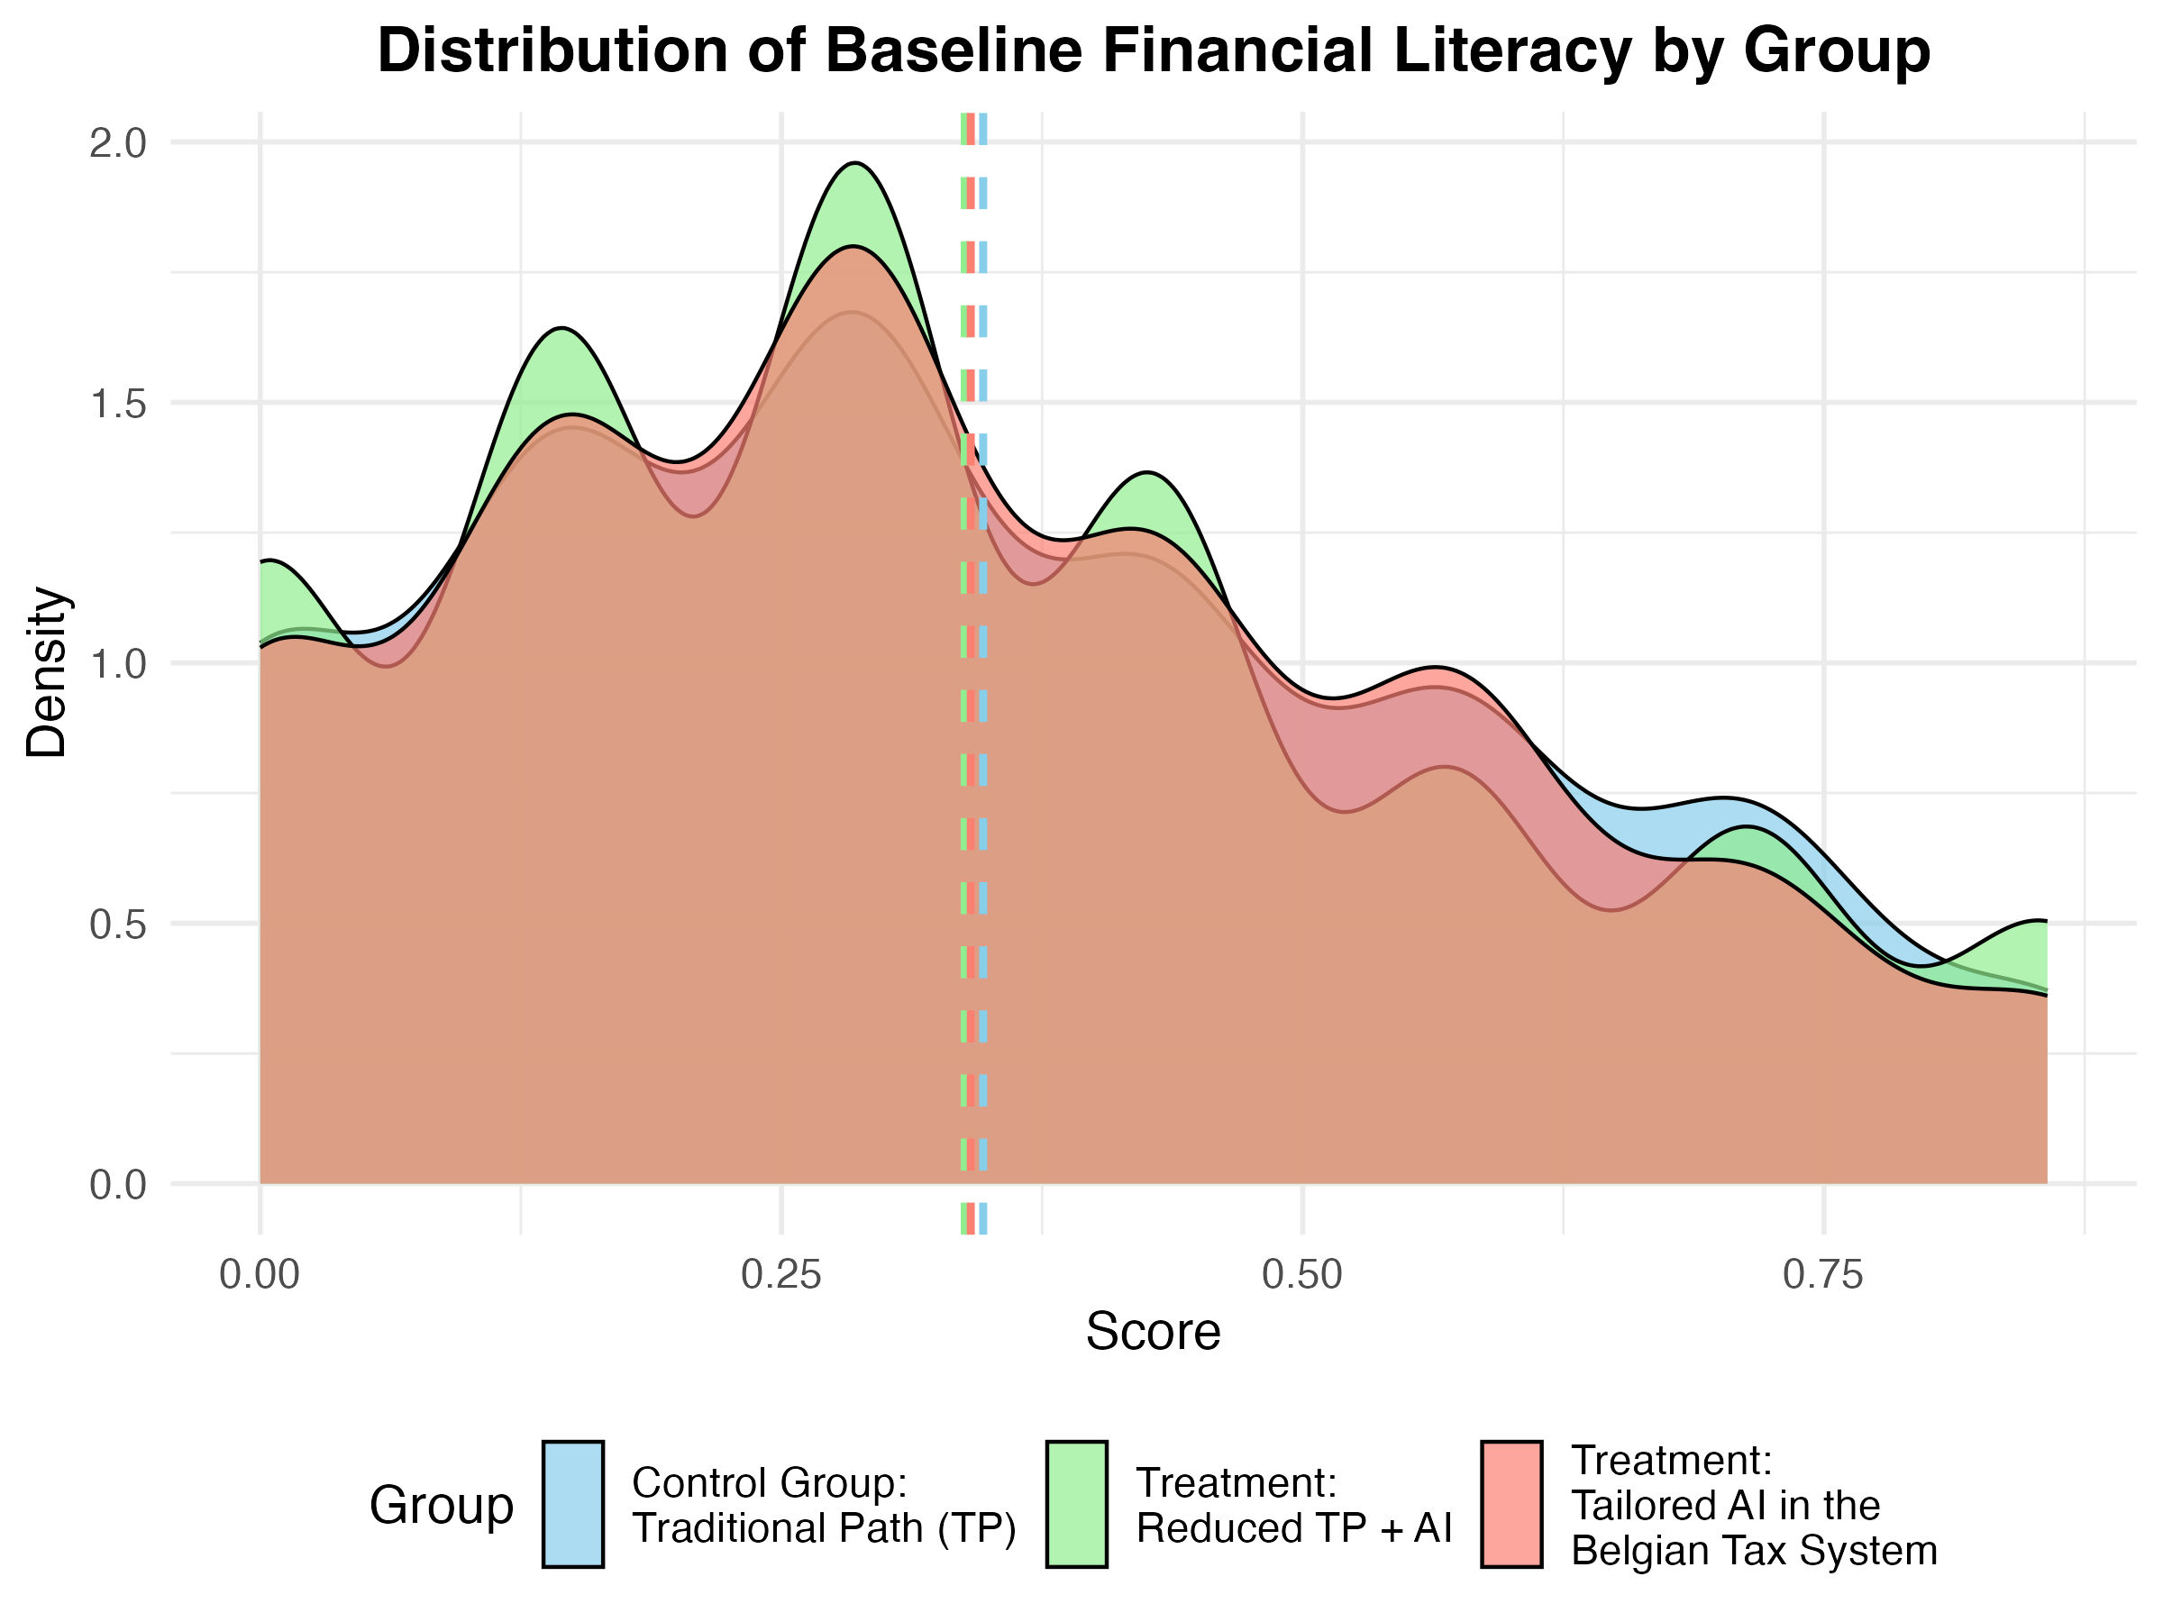
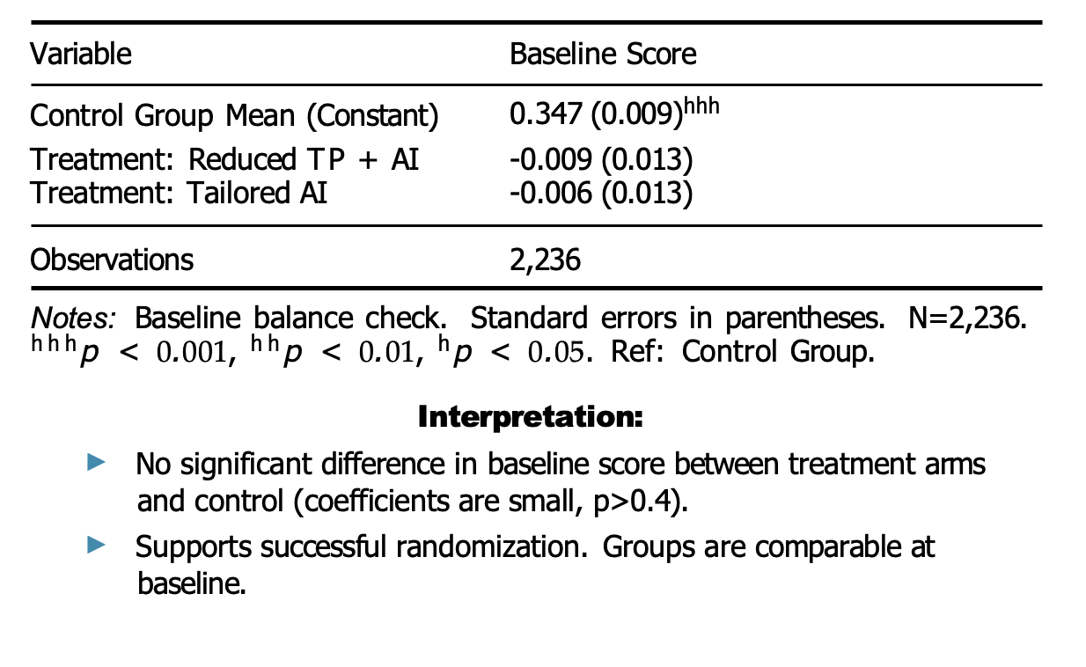
Randomization Check: Baseline Score Balance
Figure: : Kernel density plot of baseline financial literacy scores for Control (likely Blue), Treatment 1 (Reduced TP+AI, likely Green), and Treatment 2 (Tailored AI, likely Red). Distributions appear very similar.

Slide 16
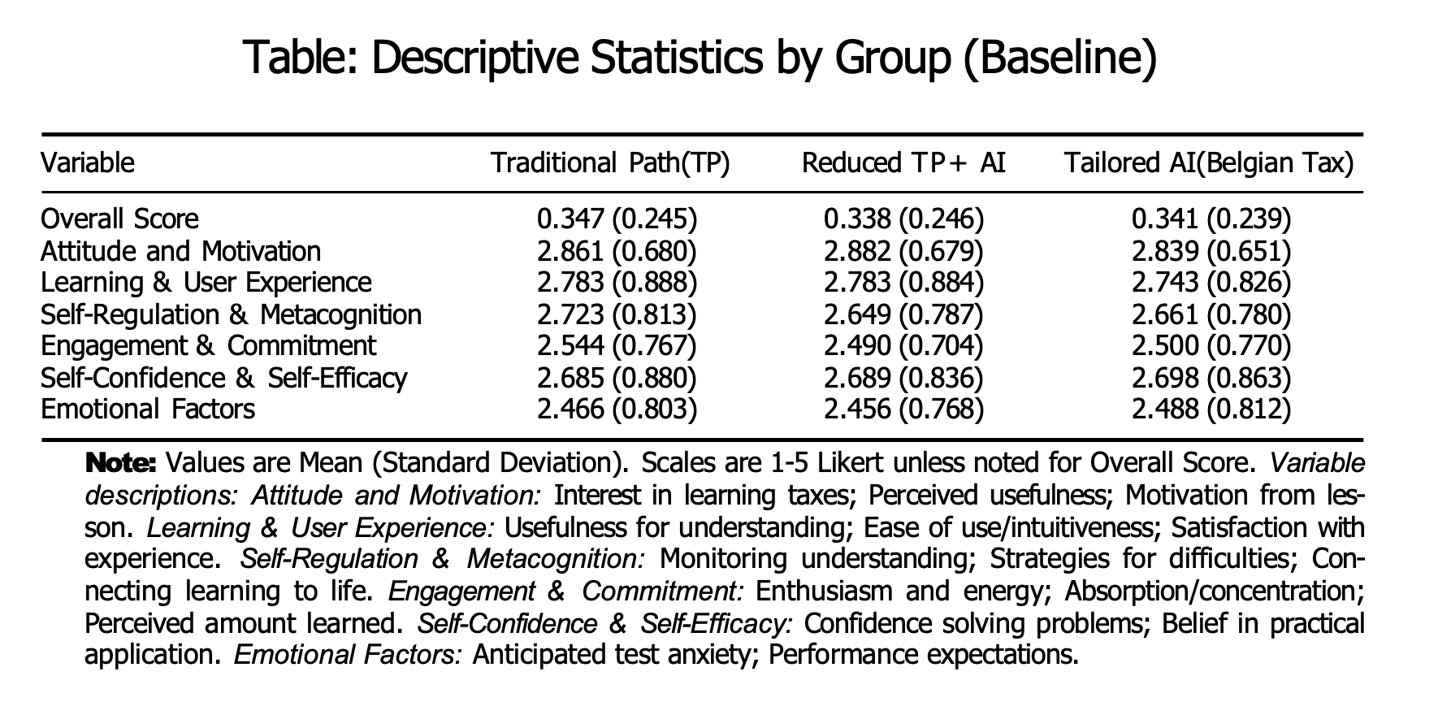
Baseline Outcomes Balance

Slide 17
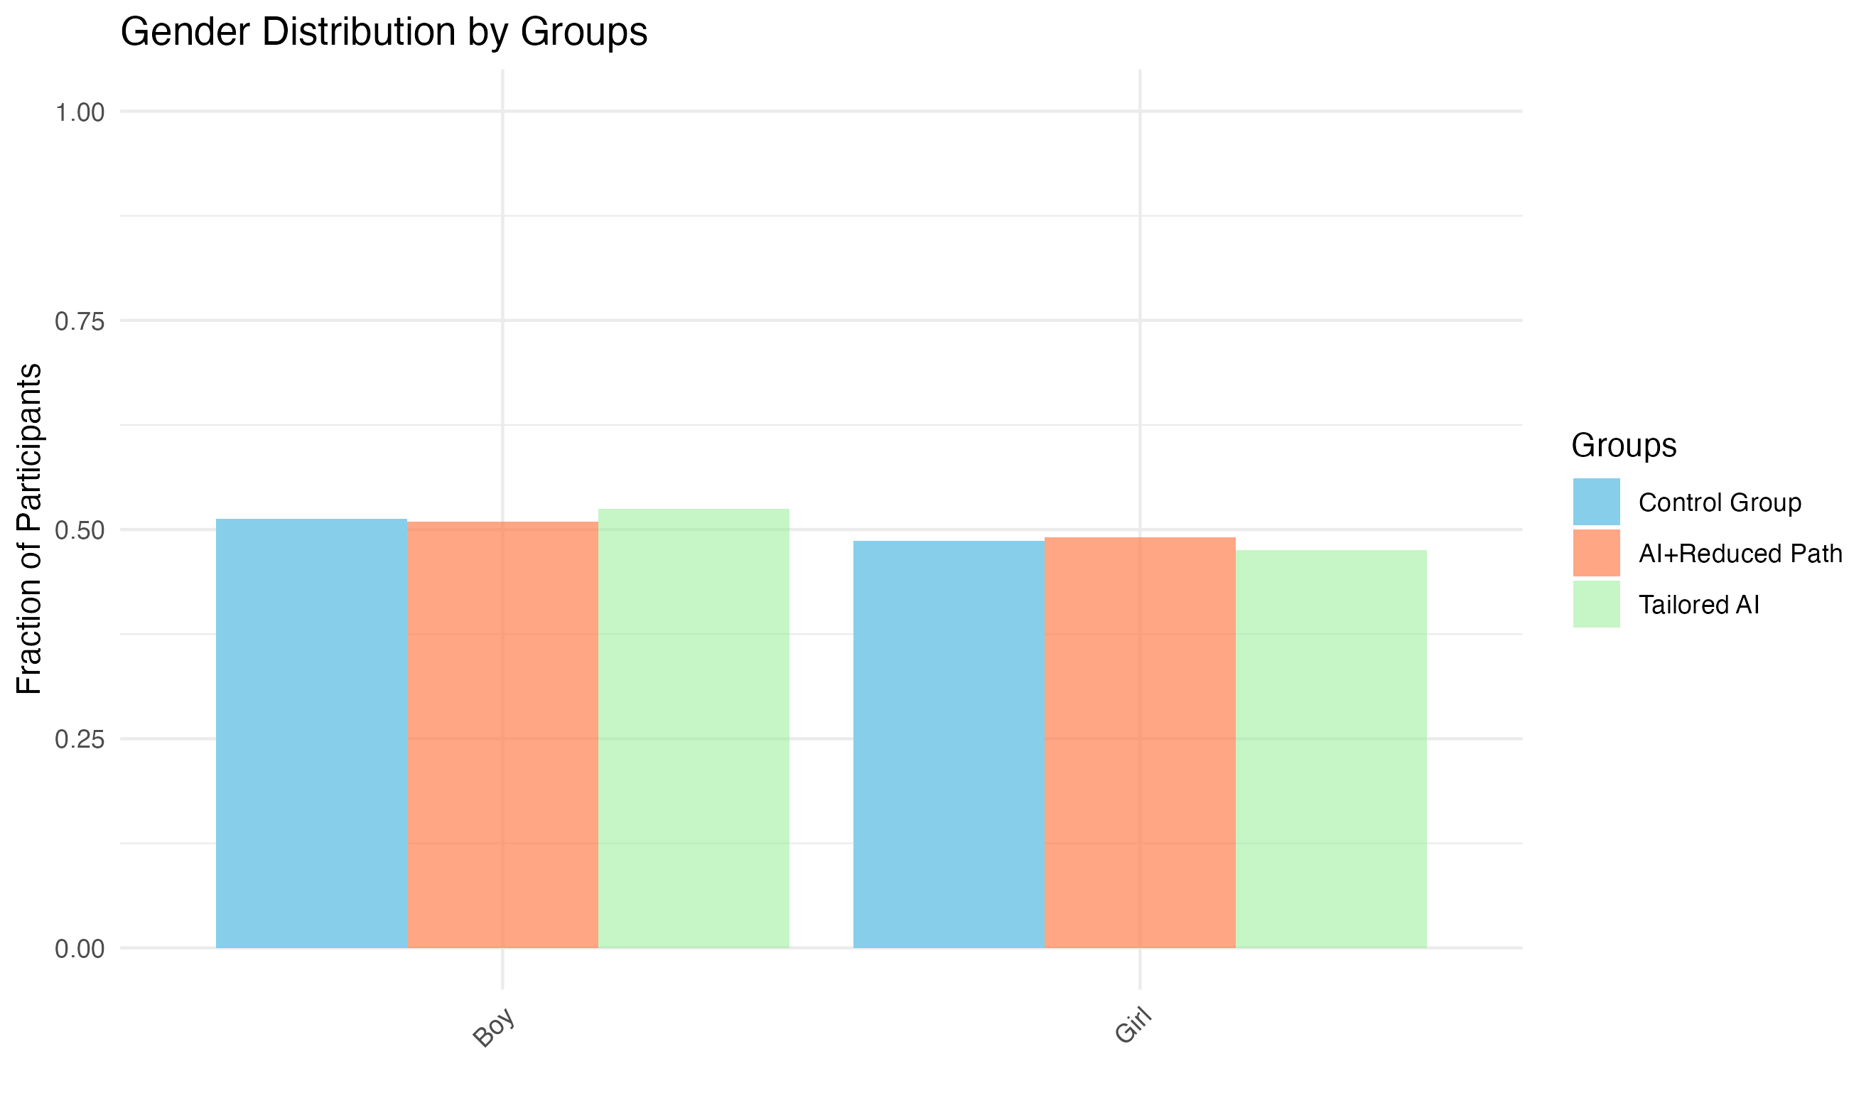
Baseline Characteristics: Gender Balance
Gender distribution compared across groups at baseline.
Test: Pearson’s χ2(2) = 0.74, p = 0.946.
Conclusion: Groups well-balanced on gender.

Slide 18
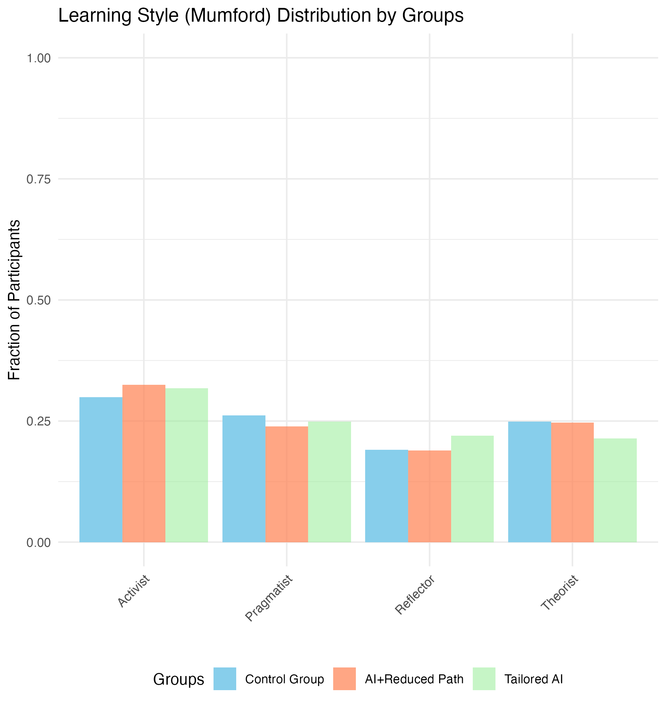
Baseline Characteristics: Learning Style (Murford) Balance
Learning Style distribution compared across groups at baseline.
Test: Pearson’s χ2(6) = 5.36, p = 0.49
Honey and Mumford Learning Style:
Activist: Learns best by doing and experiencing.
Reflector: Learns best by observing and thinking things through.
Theorist: Learns best by understanding concepts, and the logic behind things.
Pragmatist: Learns best when they see a practical application

Slide 19
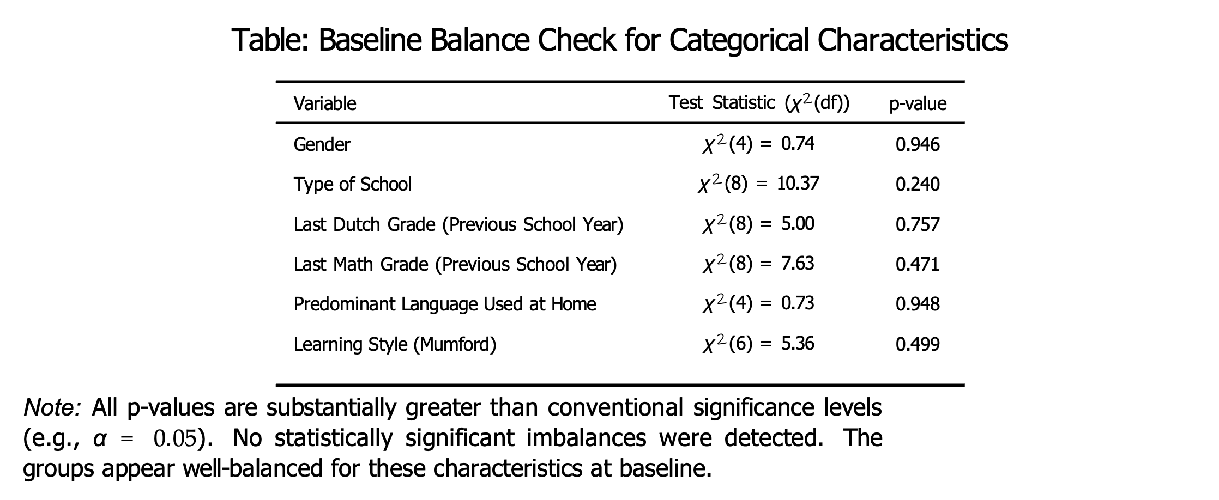
Baseline Balance: Categorical Variables
Notes:
degrees of freedom (df)

Slide 20
Results
4
20
20
Faculty, department, unit ...
Faculty, department, unit ...

Slide 21
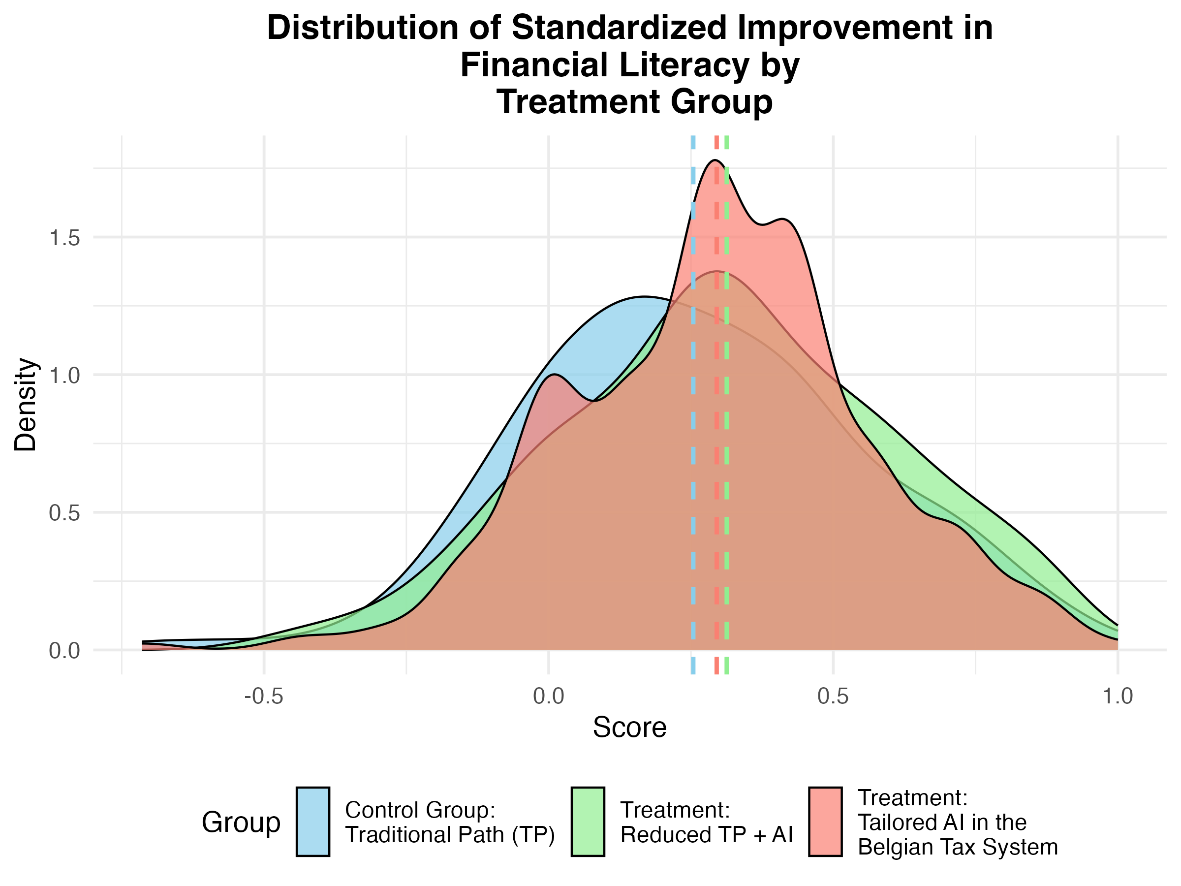
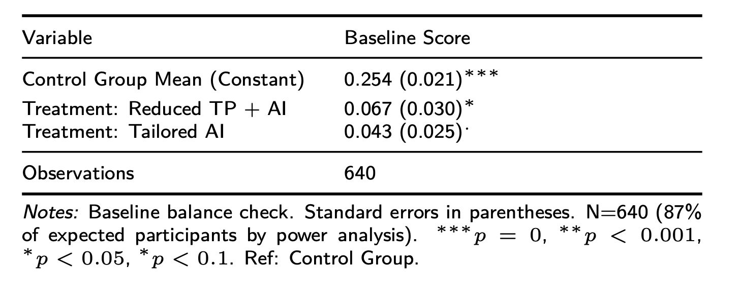
Main Result - Gained Learning
Figure: Kernel density plot of gained learning observed in financial literacy scores

Slide 22
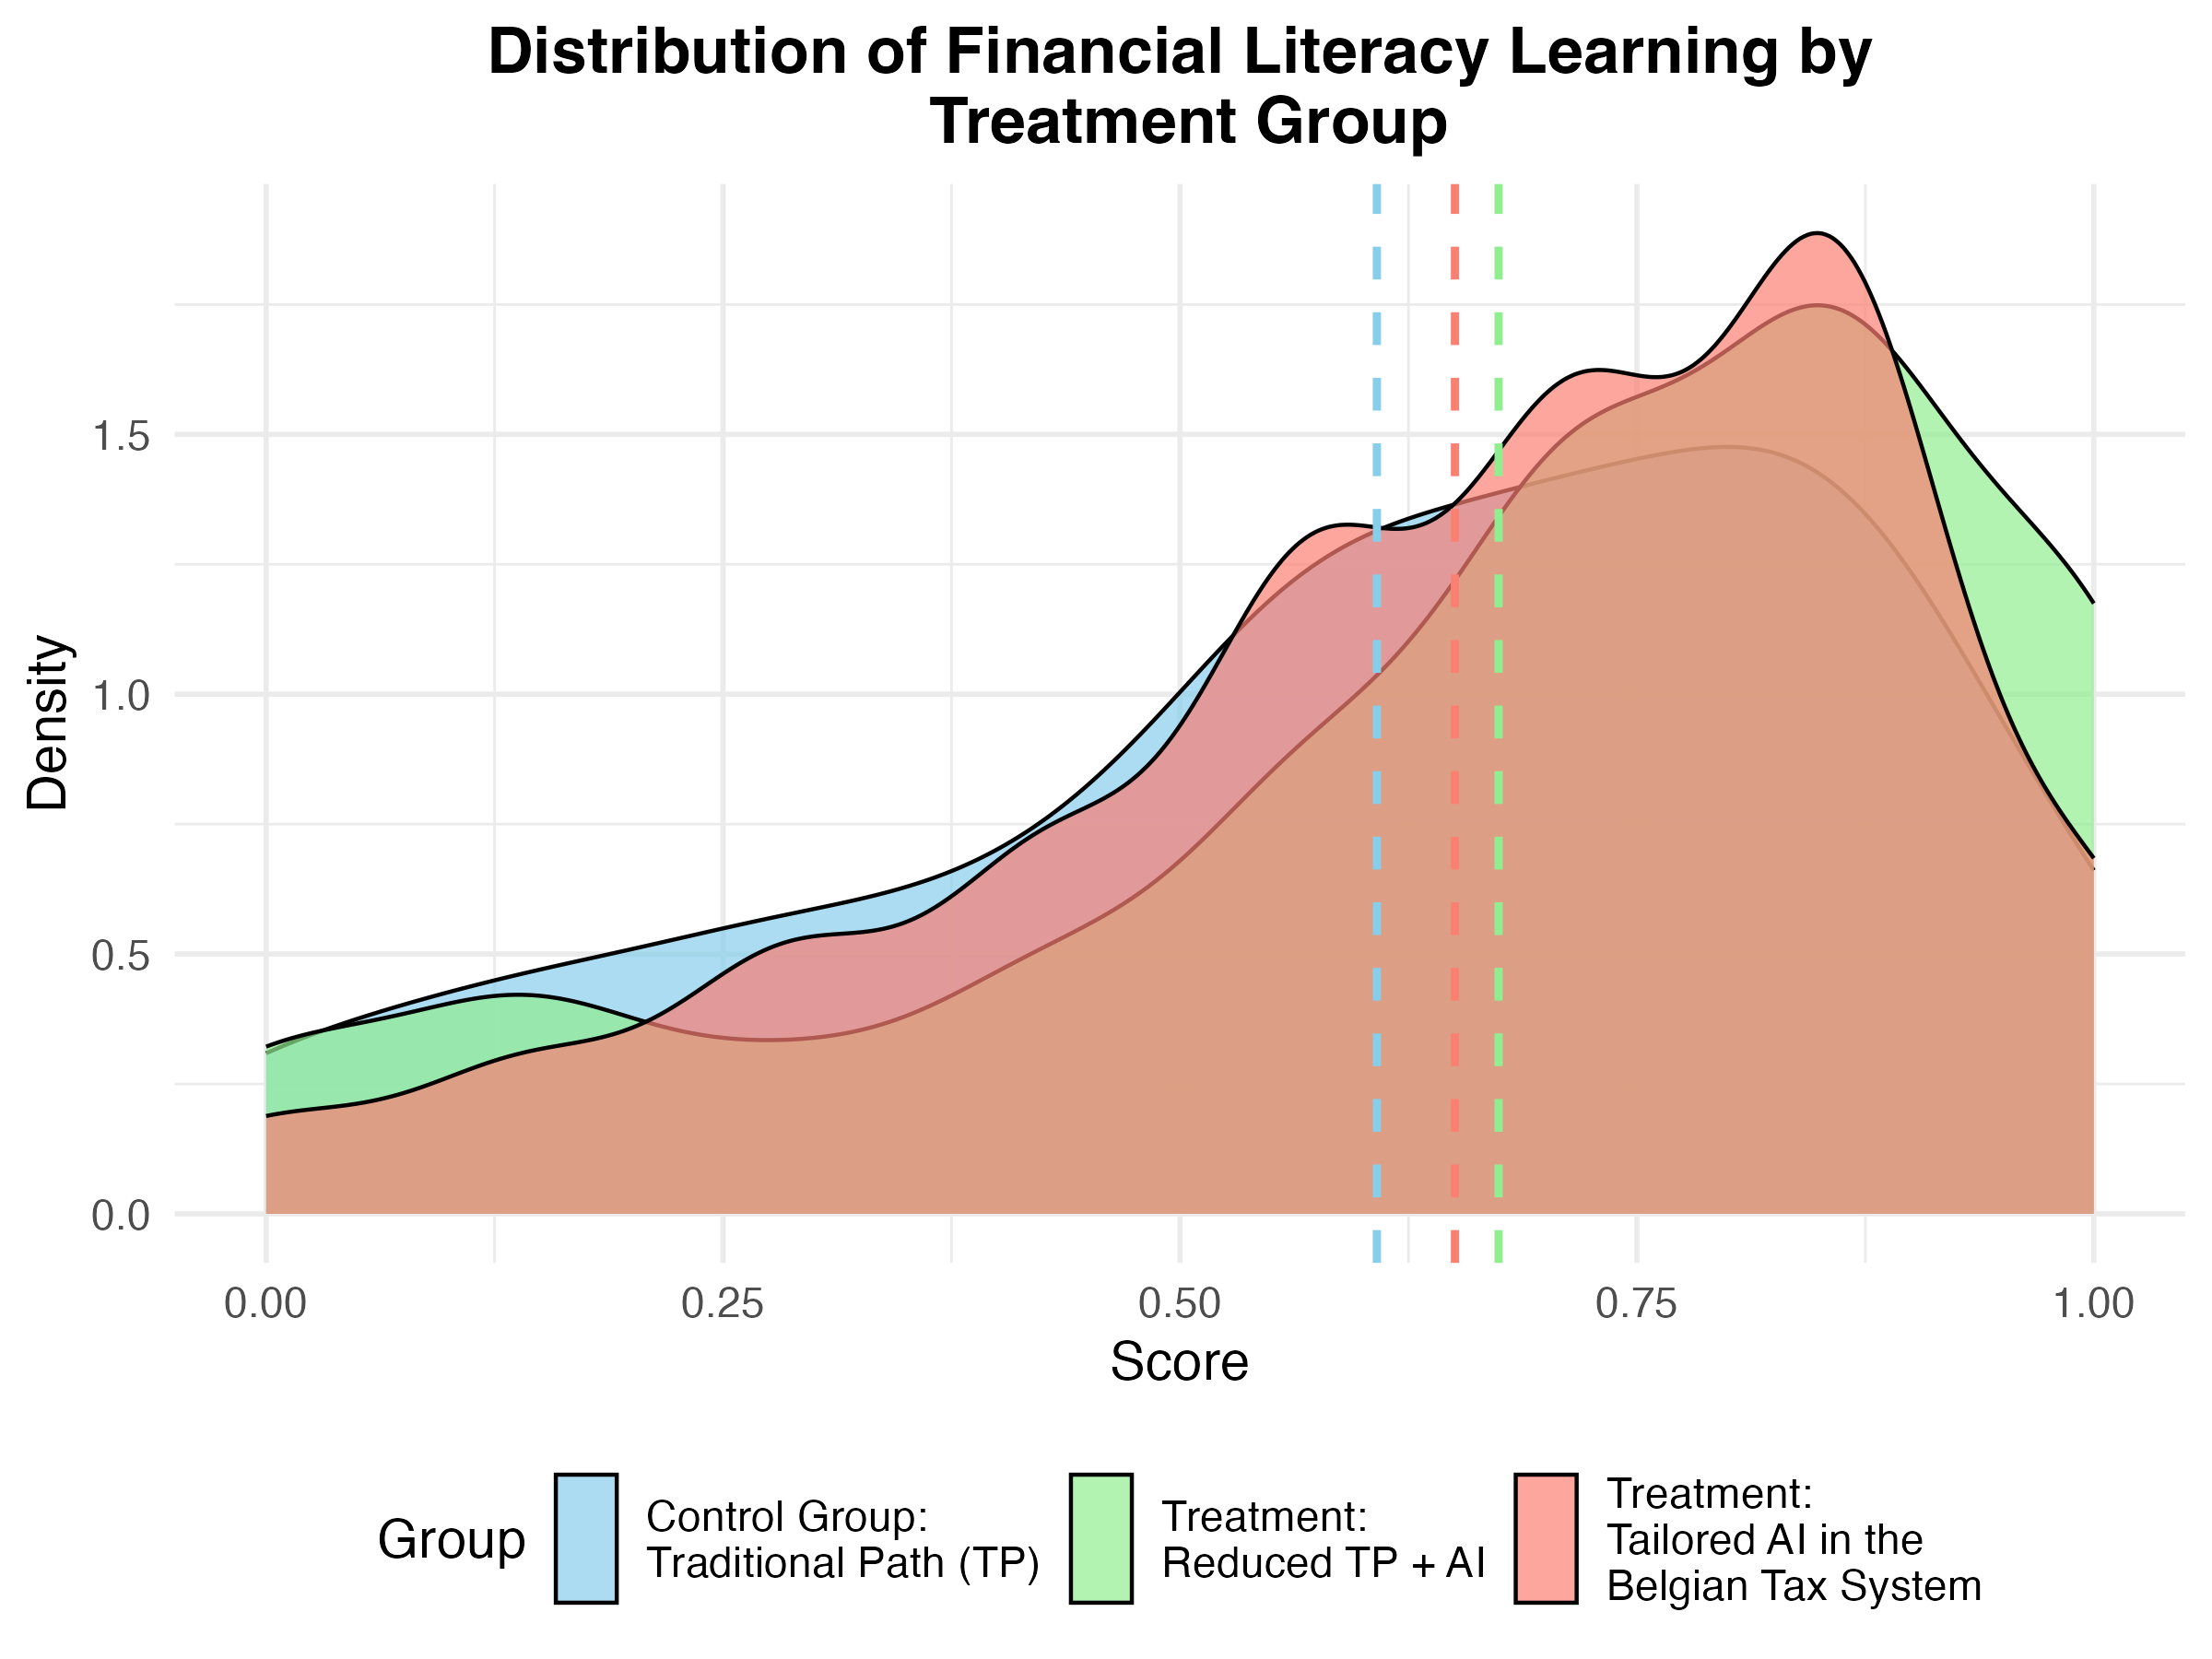
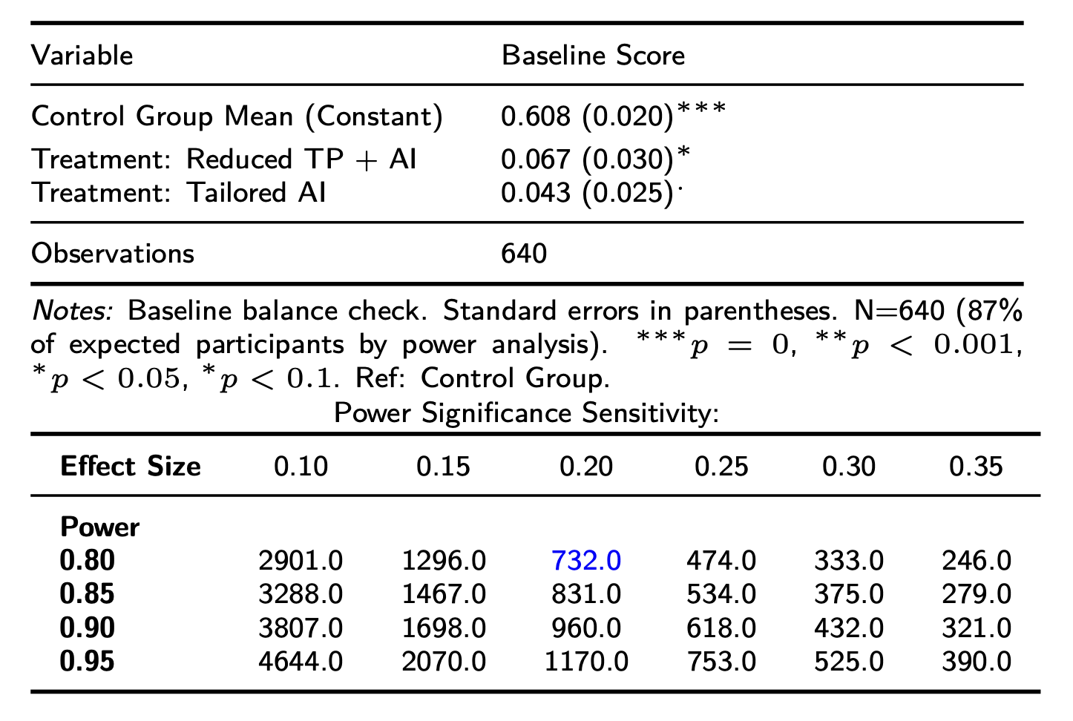
Main Result - Gained Learning
Figure: Kernel density plot of gained learning observed in financial literacy scores

Slide 23
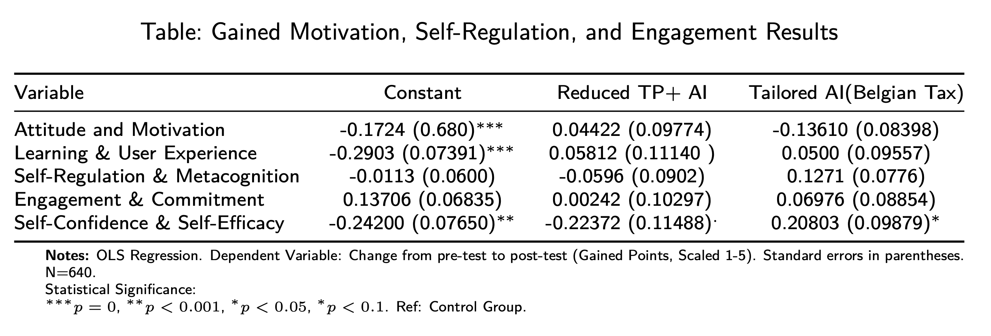
Motivation, Self-Regulation, and Engagement Results

Slide 24
Heterogeneities
3
24
24
Faculty, department, unit ...
Faculty, department, unit ...

Slide 25
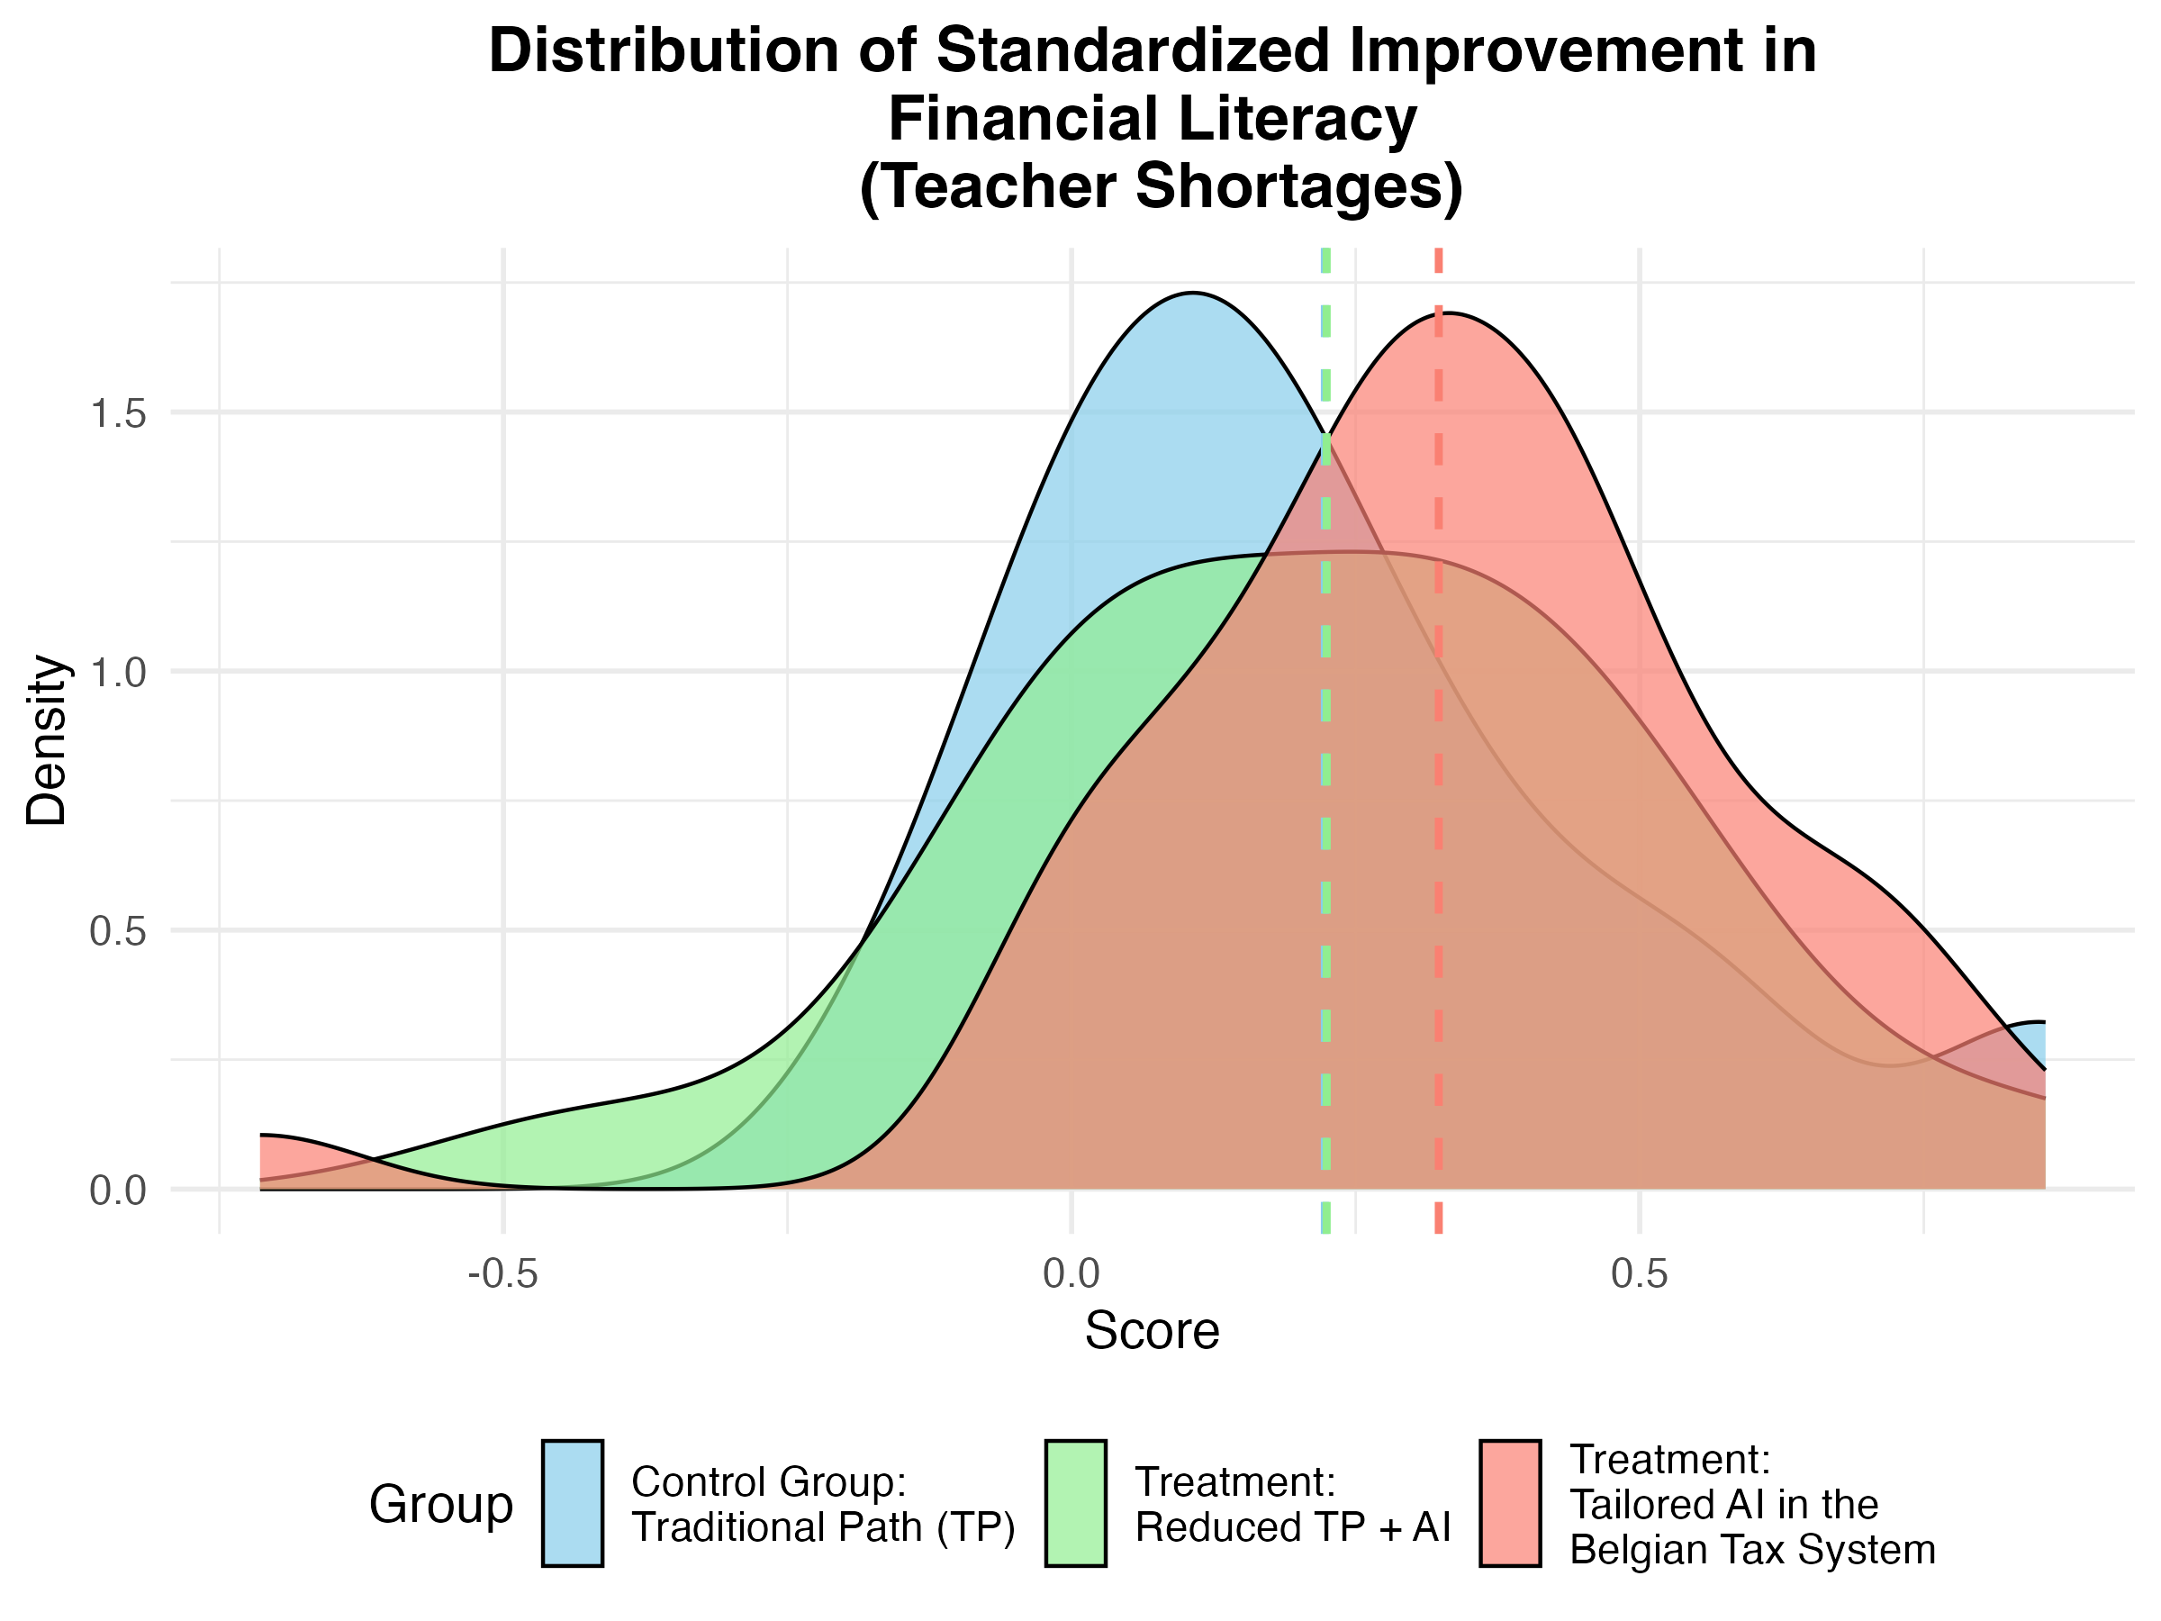
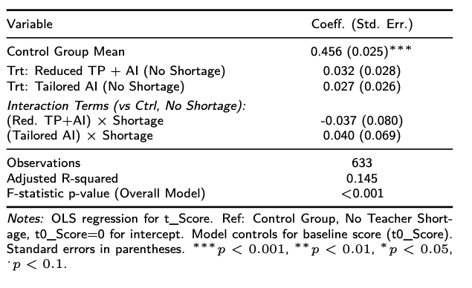
Schools with Teacher Shortages - Gained Learning
In this model, we did not find statistically significant evidence that the interventions (Reduced TP + AI, Tailored AI) had a different impact on post-intervention scores in schools with teacher shortages compared to schools without them.
Figure: Kernel density plot of gained learning observed in financial literacy scores

Slide 26
Robustness
6
26
26
Faculty, department, unit ...
Faculty, department, unit ...

Slide 27
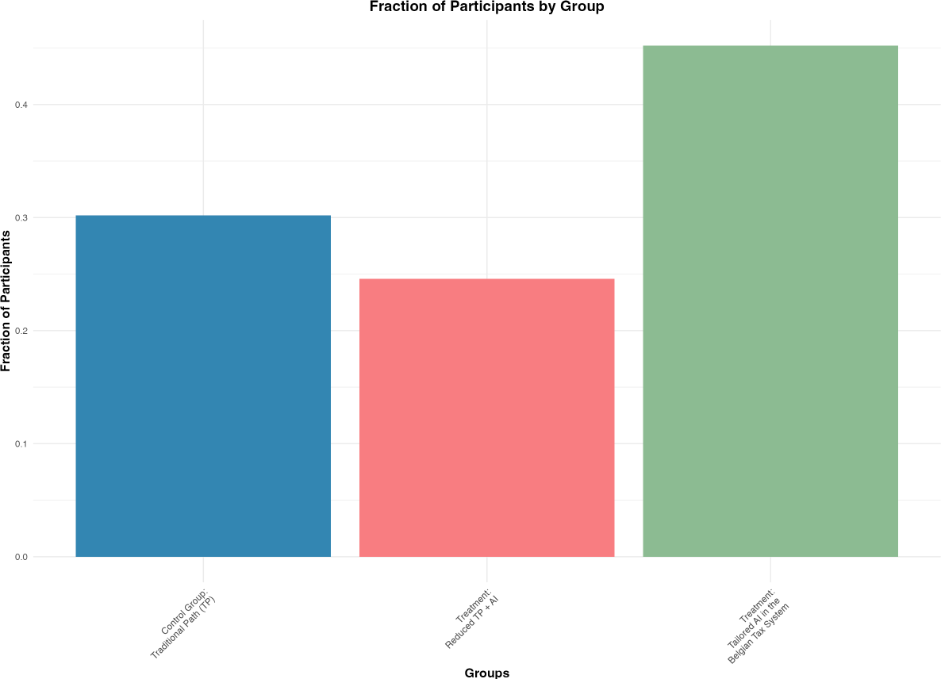
The Challenge of Attrition in RCTs
In an ideal RCT, random assignment ensures baseline equivalence, allowing for direct causal inference. However, participants may not complete the intervention, leading to attrition.
Figure: Fraction of participants completing the learning path by group: Control (Traditional Path): 30.2%, Treatment 1 (Reduced TP + AI): 24.6%, Treatment 2 (Tailored AI): 45.2%.

Slide 28
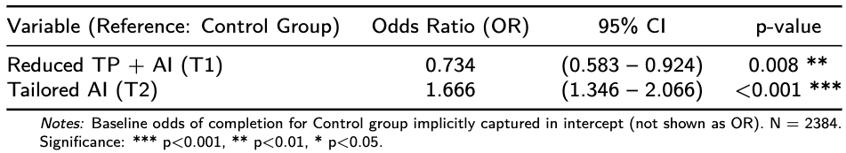
Attrition Check: Differential Compliance with Treatment Assignment
We formally assess if compliance (i.e., completing the intervention) differs based on the randomly assigned treatment group. This examines if there's differential treatment uptake.
Where: Where: Completed_{i} = 1 if student i completed the intervention, 0 if attrited. AssignedGroup_{i} is the initial random assignment. We examine the Odds Ratios (e^{β1} ).
Interpretation:
Students in the Reduced TP + AI group had significantly lower odds (approx. 26.6% lower) of completing, suggesting lower treatment uptake or higher disutility of participation for this arm.
Students in the Tailored AI group had significantly higher odds (approx. 66.6% higher) of completing, indicating higher compliance or perceived utility.
Conclusion: Attrition is non-random with respect to treatment assignment. This differential compliance implies that analyses on completers only may suffer from selection bias.

Slide 29
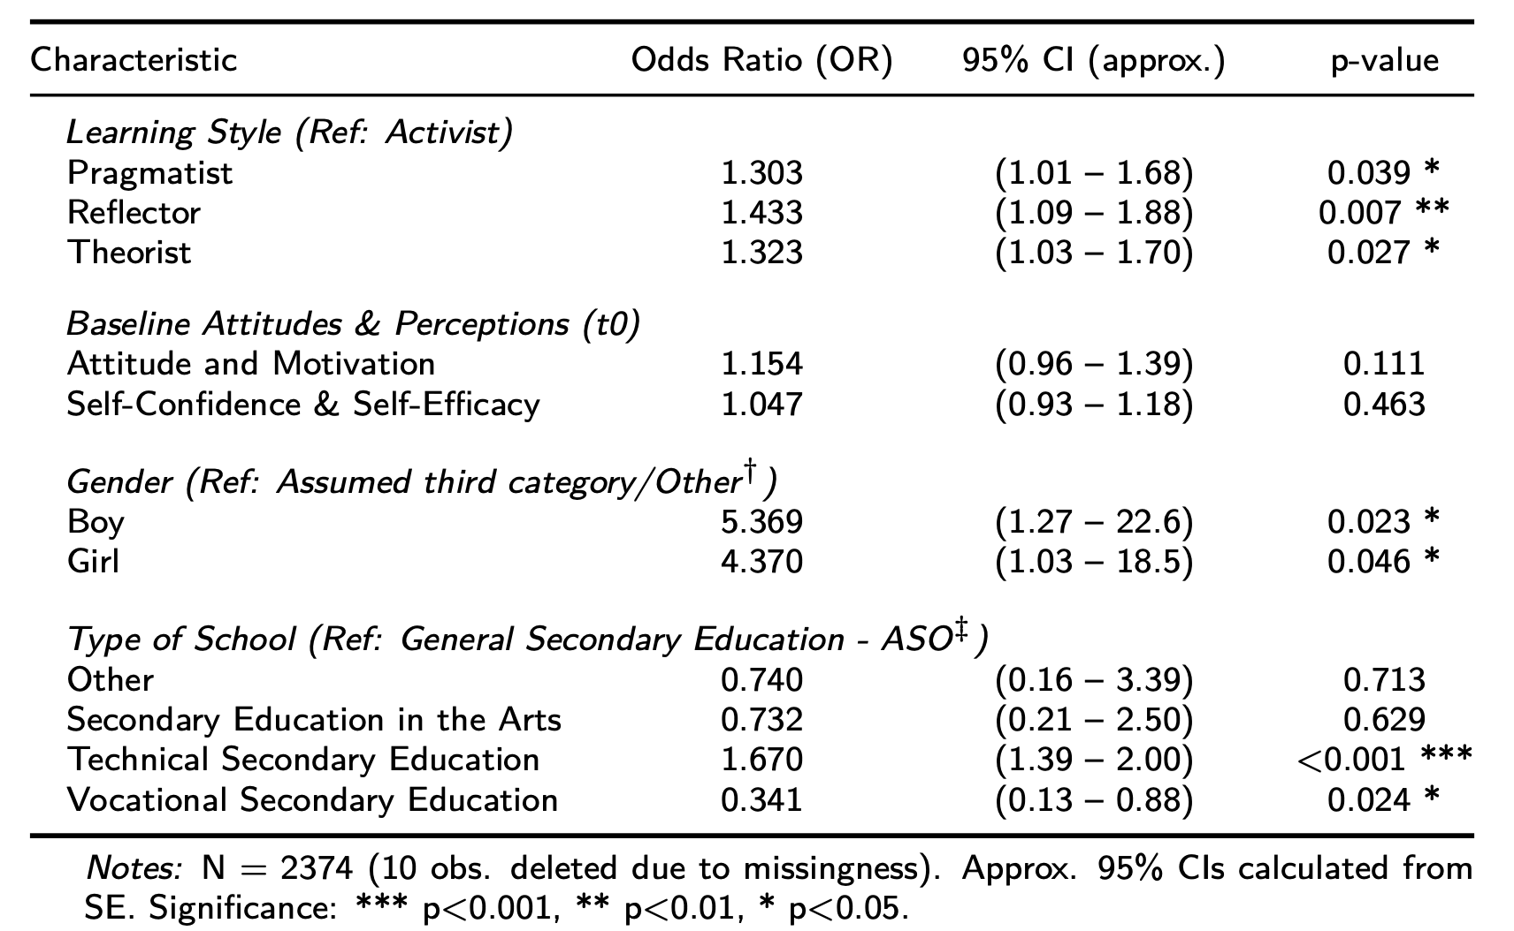
Attrition Check: Evidence of Selection on Pre-Treatment Characteristics
We further use logistic regression to investigate if attrition is related to baseline student and school characteristics, which could indicate selection on observables among those who complete.
Key Finding: The sub-sample of completers is systematically different from the original randomized sample based on observable pre-treatment characteristics

Slide 30
The Challenge of Non-Random Attrition: Implications for Causal Inference
We use logistic regression to investigate if attrition is related to baseline student and school characteristics.
Recap of the Problem:
Attrition is significantly related to the randomly assigned treatment group, indicating differential compliance or treatment uptake.
Attrition is also significantly related to baseline student and school characteristics, indicating selection on observables (and potentially unobservables correlated with these)
Consequently, OLS estimates of treatment effects on completers only are likely biased due to this selection bias. Such estimates:
Suffer from endogeneity, as the decision to complete is correlated with factors that may also affect outcomes.Attrition is also significantly related to baseline student and school characteristics.
To obtain a more credible causal estimate, we need a method that accounts for this non-random selection into treatment completion

Slide 31
Addressing Selection Bias: The Instrumental Variable (IV) Strategy
Instrumental Variable (IV) Strategy: We use the initial random assignment to a treatment group (Z_{i} = AssignedGroup_{i}) as an instrument for actual treatment completion/participation
IV Assumptions Justification::
Relevance: The instrument (Zi) must strongly predict actual treatment completion (Di).
Our previous logistic regression confirmed this: assigned group significantly predicts completion odds.
The first-stage F-statistic (reported later as 33.18) is well above the conventional threshold of 10, indicating a strong instrument.Attrition is also significantly related to baseline student and school characteristics, indicating selection on observables (and potentially unobservables correlated with these)
Exclusion Restriction: The instrument (Zi) must affect the outcome (Gained Learning, Yi) only through its influence on actual treatment completion (Di), and not through any other pathway.
Justification: Random assignment ensures Zi is, by design, exogenous (uncorrelated with pre-treatment student/school characteristics, observed or unobserved, that could independently affect Yi, except via Di).
Balance checks support this for observed characteristics. The instrument isolates exogenous variation in treatment take-up.

Slide 32
Estimating Causal Effects via IV: The Local Average Treatment Effect (LATE)
Our analysis showed differential compliance: completion rates differed significantly based on initial random assignment.
This non-random attrition leads to selection bias in OLS estimates on completers, as ’treatment received’ (completion) becomes an endogenous variable.
Solution: Instrumental Variable (IV) Estimation using Two-Stage Least Squares (2SLS).
Interpretation: With the IV assumptions reasonably met, this approach provides a consistent estimate of the Local Average Treatment Effect (LATE).
The LATE is the average causal effect of the intervention specifically for the sub-population of ‘compliers’.
Compliers are individuals whose treatment status (i.e., whether they completed the intervention or not) was changed by their random assignment to a particular treatment group.

Slide 33
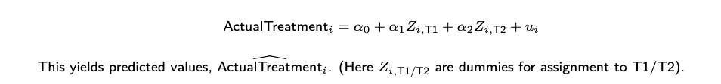
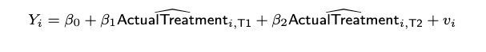
The IV Mechanism: Two-Stage Least Squares (2SLS)
The Two Stages:
First Stage: Predict actual treatment received/completed (the endogenous regressor, ActualTreatment_{i}) using the exogenous randomly assigned group (the instrument, Zi).
Second Stage: Estimate the effect of this instrumented (exogenously driven component of) treatment on Gained Learning (Y_{i}).
β₁ and β₂ estimate the Local Average Treatment Effect (LATE) for each treatment arm relative to the control: the causal effect for compliers—those students whose participation was influenced by the initial random assignment.

Slide 34
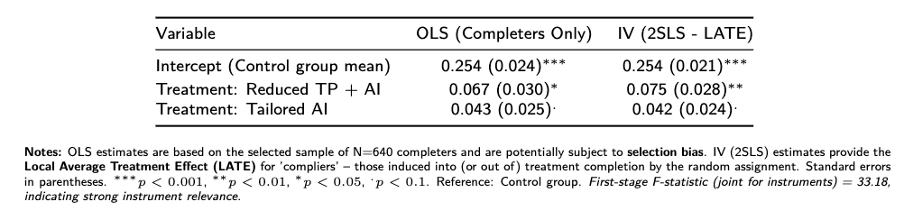
Comparing Estimates: OLS (on Completers) vs. IV (LATE)
Interpretation Points:
The LATE for "Reduced TP + AI" (0.075 sd) is slightly larger and more significant than its OLS counterpart, suggesting OLS might have underestimated the effect for compliers.
The LATE for "Tailored AI" (0.042 sd) is very similar to OLS, implying that for this arm, selection effects among completers might be less pronounced or net out regarding the LATE.
LATE identifies effects for a specific sub-population (compliers); differences from OLS can reflect both bias correction and estimation on different populations defined by compliance behavior

Slide 35
The Impact of AI-Supported Learning on Financial Literacy: Evidence from a Randomized Controlled Trial
Thanks!
Jaime Polanco-Jimenez
jaime.polancojimenez@kuleuven.be
Kristof De Witte
kristof.dewitte@kuleuven.be

